Slide 1
Naïve Bayes Classification

Slide 2
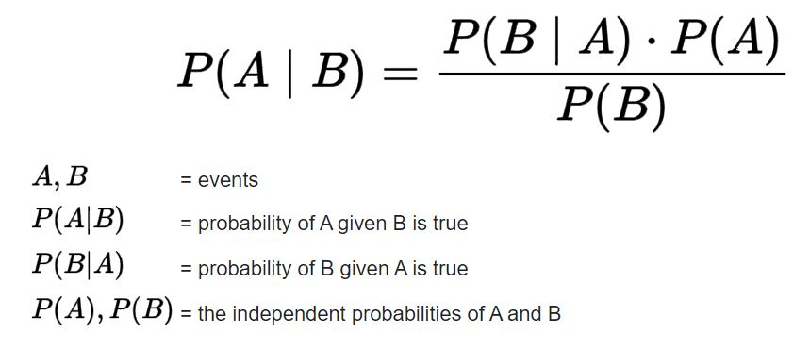
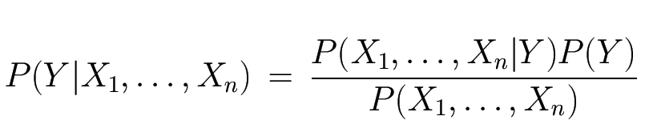
Bayes Theorem
Derived from conditional probability: likelihood of an event or outcome occurring, based on the occurrence of a previous event or outcome
Posterior/conditional
probability
Likelihood
Prior
Normalization Constant

Slide 3
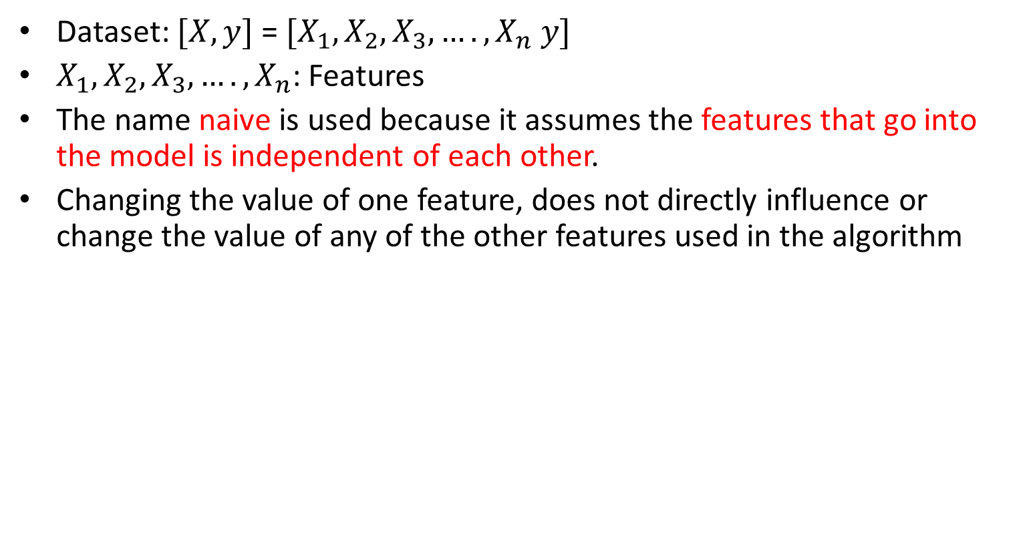
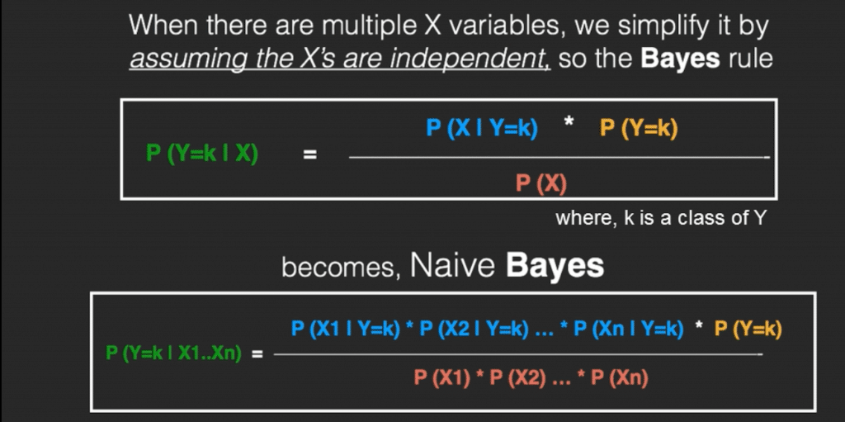
Naïve Bayes: innocent/unsophisticated

Slide 4
Naïve Bayes: innocent/unsophisticated
Each feature is given the same weight (or importance).

Slide 5
Example of the Naïve Bayes Classifier
Outlook feature
Temperature feature
Likelihood Table
 | Yes | No | P(Y) | P(N)
Sunny | 2 | 3 | P(S|Y) 2/9 | P(S|N) 3/5
Overcast | 4 | 0 | P(O|Y) 4/9 | P(0|N) 0/5
Rainy | 3 | 2 | P(R|Y) 3/9 | P(R|N) 2/5
Total | 9 | 5
Yes | 9 | P(Y) 9/14
No | 5 | P(N) 5/14
Total | 14
Likelihood Table
 | Yes | No | P(Y) | P(N)
Hot | 2 | 2 | P(H|Y) 2/9 | P(H|N) 2/5
Mild | 4 | 2 | P(M|Y) 4/9 | P(M|N) 2/5
Cool | 3 | 1 | P(C|Y) 3/9 | P(C|N) 1/5
Total | 9 | 5

Slide 6
Test data: Sunny, Hot: Features
P (Yes|Today) = Probability of Yes given {Sunny, Hot}= P(S|Y)×P(H|Y)×P(Y)= 2/9×2/9×9/14=2/63=0.031
P (No|Today) = Probability of No given {Sunny, Hot}= P(S|N)×P(H|N)×P(N)=3/5×2/5×5/14=3/35=0.085
Normalized: Probability of Yes given {Sunny, Hot}= 0.031/(0.031+0.085)=0.267
Normalized: Probability of Yes given {Sunny, Hot}= 0.085/(0.031+0.085)=0.733
P (Yes|Today) < P (No|Today)
Therefore, the prediction is No

Slide 7
Zero-Frequency Problem of the Naïve Bayes Classifier
One of the disadvantages of Naïve-Bayes is that if there is no occurrences of a class label and a certain feature value together then the frequency-based probability estimate will be zero. And this will get a zero when all the probabilities are multiplied.
P (Yes|Today) = Probability of Yes given {Overcast, Hot}= P(O|Y)×P(H|Y)×P(Y)= 0×2/9×9/14= 0
An approach to overcome this ‘zero-frequency problem’ is to add one to the count for every attribute value-class combination when an attribute value doesn’t occur with every class value: Laplace/Additive Smoothing

Slide 8
Different types of Naïve Bayes
Multinomial Naive Bayes: Most common one. Suitable for discrete/multi-categorical data
Gaussian Naive Bayes: Suitable for continuous data where probabilities can be modeled using a Gaussian/Normal distribution
Bernoulli Naive Bayes: Like MultinomialNB, this classifier is suitable for discrete (binary-categorical) data. The difference is that while MultinomialNB works with occurrence counts, BernoulliNB is designed for binary/Boolean features

Slide 9
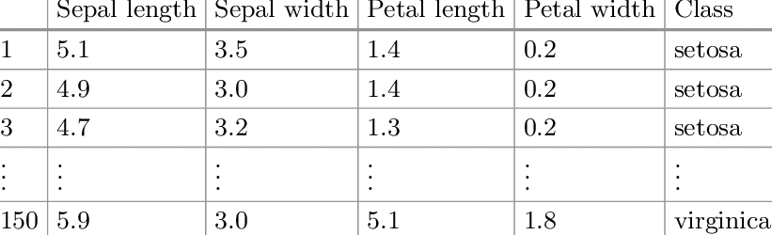
The iris dataset contains three classes of flowers of 50 samples in each classes, Versicolor, Setosa, Virginica, and each class contains 4 features, ‘Sepal length’, ‘Sepal width’, ‘Petal length’, ‘Petal width’.
P(Setosa) = P(Versicolor) = P(Virginica) = 50/150 = 1/3
1. Mean_SL_Setosa, Mean_SW_Setosa, Mean_PL _Setosa, Mean_SL _Setosa
STD_SL _Setosa, STD_SW _Setosa, STD_PL _Setosa, STD_SL _Setosa
2. Mean_SL_Versicolor, Mean_SW_Versicolor,, Mean_PL _Versicolor,, Mean_SL _Versicolor,
STD_SL _Versicolor, STD_SW _Versicolor,, STD_PL _Versicolor,, STD_SL _Versicolor,
3. Mean_SL_Virginica, Mean_SW_ Virginica, Mean_PL _ Virginica, Mean_SL _ Virginica
STD_SL _ Virginica, STD_SW _ Virginica, STD_PL _ Virginica, STD_SL _ Virginica

Slide 10

Test sample: SL = 4.85, SW = 3.15, PL = 1.36, PW = 1.12
P₁=P(Setosa|TS) = P(TS|Setosa) × P(Setosa) = P(SL|Setosa) × P(SW|Setosa) × P(PL|Setosa) × P(PW|Setosa) × P(Setosa)
P₂=P(Versicolor|TS) = P(TS|Versicolor) × P(Versicolor) = P(SL|Versicolor) × P(SW|Versicolor) × P(PL|Versicolor) × P(PW|Versicolor) × P(Versicolor)
P₃=P(Virginica|TS)
Compare P_{1,} P₂ and P₃
modeled with Gaussian distribution

